Slide 1


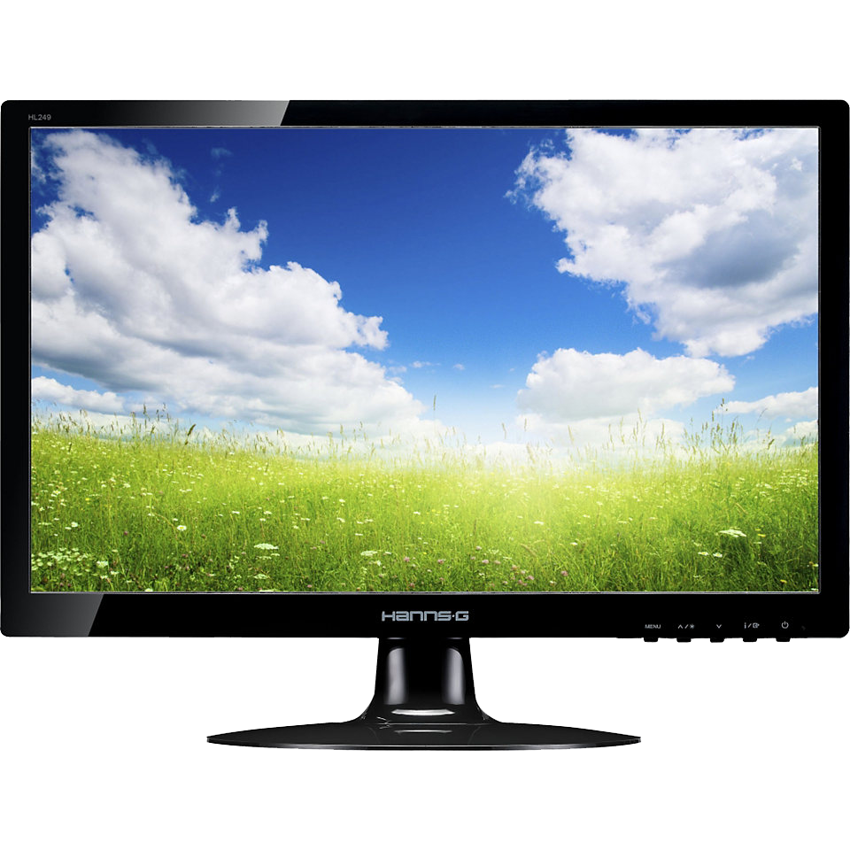
Monitors
A monitor is an electronic output device that is also known as a video display terminal (VDT) or a video display unit (VDU).
It is used to display images, text, video, and graphics information generated by a connected computer via a computer's video card.
Although it is almost like a TV, its resolution is much higher than a TV.
The first computer monitor was introduced on 1 March 1973, which was part of the Xerox Alto computer system.

Slide 2
History
1980's
VDT and terminals monitors introduced in 1980's. They only displayed text in 2 colors usually black and green.
1981
In 1981 IBM introduced the CRT monitors which could display 16colors.
1987
XGA and UXGA introduced in 1987 can display up to 16 million colors.
1990's
LCD monitors were introduced.
2006
In 2006, Jeff Han released the first interface-free, touch-based monitor at TED.
2017
In 2017, touch screen LCD monitors became more affordable for the customers as they started to decrease the price.

Slide 3
Types of Monitors
Cathode Ray Tube (CRT) Monitors
Flat Panel Monitors
Touch Screen Monitors
LED Monitors
OLED Monitors
DLP Monitors
TFT Monitors
Plasma Screen Monitors

Slide 4
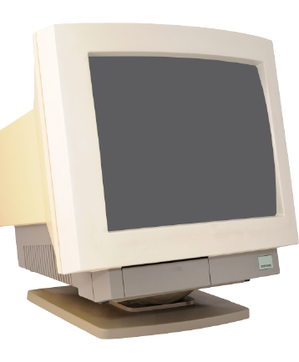
1. Cathode Ray Tube (CRT) Monitors
It is a technology used in early monitors. It uses a beam of electrons to create an image on the screen.
It comprises the guns that fire a beam of electrons inside the screen.
The electron beams repeatedly hit the surface of the screen.
These guns are responsible for generating RGB (Red, Green, Blue) colors, and more other colors can be generated with the help of combining these three colors.
Today's Flat Panel Monitors replace the CRT monitors.

Slide 5
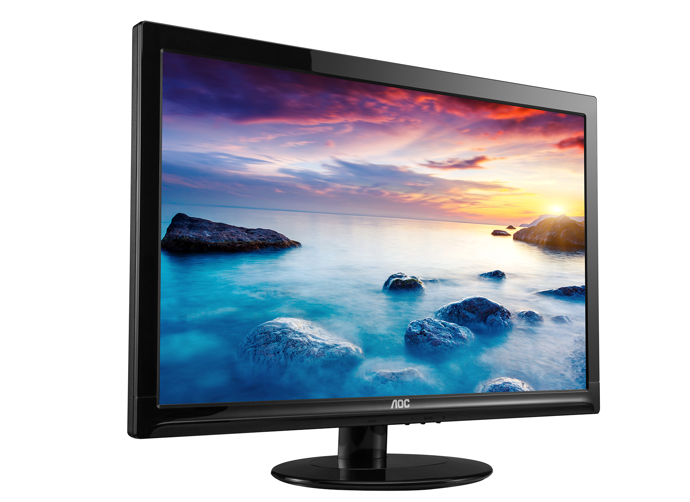
2. Flat Panel Monitors
These types of monitors are lightweight and take less space. They consume less power as compared to CRT monitors.
These monitors are more effective as they do not provide harmful radiation.
These monitors are more expensive than CRTs.
The flat-panel monitors are used in PDA, notebook computers, and cellular phones.
These monitors are available in various sizes like 15", 17", 18" & 19" and more.
The display of a flat-panel monitor is made with the help of two plates of glass.
These plates contain a substance, which is activated in many ways.

Slide 6
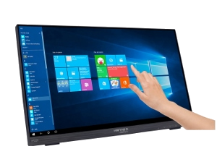
3. Touch Screen Monitors
These monitors are also known as an input device.
It enables users to interact with the computer by using a finger or stylus instead of using a mouse or keyboard.
When users touch the screen by their finger, it occurs an event and forward it to the controller for processing.
These types of screens include pictures or words that help users to interact with the computer.
takes input from the users by touching menus or icons presented on the screen.

Slide 7
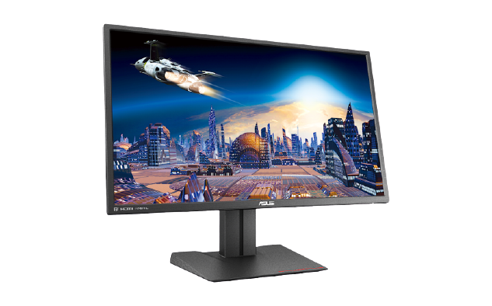
4. LED Monitors
It is a flat screen computer monitor, which stands for light-emitting diode display.
It is lightweight in terms of weight and has a short depth. As the source of light, it uses a panel of LEDs.
Nowadays, a wide number of electronic devices, both large and small devices such as laptop screens, mobile phones, TVs, computer monitors, tablets, and more, use LED displays.

Slide 8
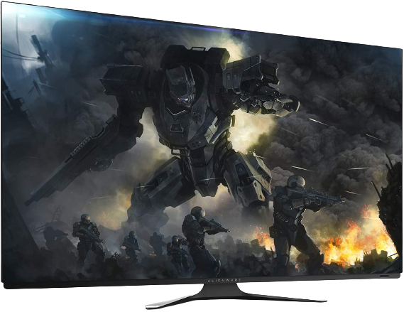
5. OLED Monitors
It is a new flat light-emitting display technology, which is more efficient, brighter, thinner, and better refresh rates feature and contrast as compared to the LCD display.
It is made up of locating a series of organic thin films between two conductors.
These displays do not need a backlight as they are emissive displays.
Furthermore, it provides better image quality ever and used in tablets and high-end smartphones.

Slide 9
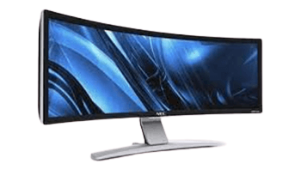
6. DLP Monitors
DLP stands for Digital Light Processing, developed by Texas Instruments.
It is a technology, which is used for presentations by projecting images from a monitor onto a big screen.
Before developing the DLP, most of the computer projection systems produced faded and blurry images as they were based on LCD technology.
DLP technology utilizes a digital micromirror device, which is a tiny mirror housed on a special kind of microchip.
Furthermore, it offers better quality pictures that can also be visible in a lit room normally.

Slide 10
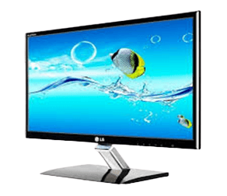
7. TFT Monitors
It is a type of LCD flat panel display, which stands for a thin-film transistor.
In TFT monitors, all pixels are controlled with the help of one to four transistors.
The high-quality flat-panel LCDs use these transistors.
Although the TFT-based monitors provide better resolution of all the flat-panel techniques, these are highly expensive.
The LCDs, which use thin-film transistor (TFT) technology, are known as active-matrix displays.
The active-matrix displays offer higher quality as compared to older passive-matrix displays.

Slide 11
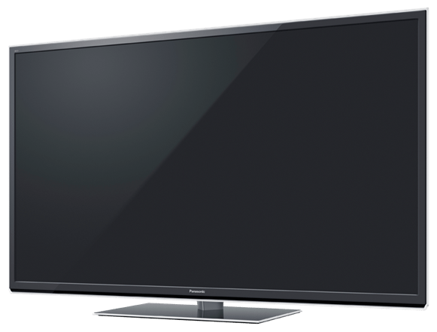
8. Plasma Screen Monitors
A plasma screen is a thin, flat-panel, and capable of hanging on a wall like LCD and LED televisions. It is a brighter screen as compared to LCD displays and thinner than CRT displays.
It can be used to either display modes of digital computer input or analog video signals, and sometimes, it is marketed as 'thin-panel' displays.
Plasma displays have wide viewing angles, high contrast ratios, and high refresh rates, which is used to reduce a blur video.
Additionally, it provides better quality pictures as it supports high resolutions of up to 1920 x 1080.

Slide 12
Thank You

